Slide 1


Our Lady of Grace Catholic Academy
After School Enrichment Activities
Autumn 2
4/11/25- 12/12/25

Slide 2
Our Lady of Grace Catholic Academy
Clubs start w/c Tuesday 4th November 2025
and will finish Friday 12th December 2025
Here at Our Lady of Grace we plan and deliver a range of meaningful opportunities outside of the classroom to broaden children’s horizons. Through the delivery of extra curricular activities we aim to provide children and families extra support, opportunities, and activities beyond the school day. These activities help children learn new skills, stay active, and build confidence in a safe and fun environment. They also support families by offering childcare, clubs, and community programs that make school a place where everyone can learn, grow, and thrive together.
This booklet outlines all the clubs available this half term.

Slide 3
Faith Formation and Reflection
Faith formation and reflection clubs will help children to develop the following values:
To trust in God’s love and grow in our relationship with Him through prayer, learning, and reflection.
To follow Jesus’ example by showing love, respect, and kindness to everyone.
To support one another, build friendships, and grow together as part of God’s family.
To take time to pray, listen to God, and reflect on how we can live our faith every day.
To learn more about our Catholic faith, the Bible, the Saints, and how to live as disciples of Jesus.
To look for ways to help others, just like Jesus taught us, showing care and compassion in our actions.
To celebrate the joy of being children of God and share that joy with others through our words and actions.
To take time to slow down, and find quiet moments to feel calm and peaceful.
To pay attention to the present moment and noticing what we think, feel, and see.
To take the time to be thankful for God, people, things, and moments that bring us joy.
To learn to notice our thoughts and emotions, helping us make calm and caring choices.
To look for the good in ourselves and the world around us, and we spread joy wherever we go.

Slide 4
Creative Clubs
Creative activities will help children to develop the following values:
To explore, investigate and experiment with a range of stimuli, techniques, approaches, materials and media
To create, design, devise their individual and collective work
To present and display work, to develop and communicate ideas and evoke responses
Use art-specific vocabulary to respond to, evaluate, explain, analyse, question their own and other peoples artistic works
To enable children to develop a wide range of skills through a variety of creative activities
To extend imagination through both knowledge and practical skills
To enable children opportunities to develop physical, intellectual, emotional and social skills through the exploration of various and/or specific mediums
Promote the development of technical knowledge and skills
To raise self-esteem and develop confidence
To develop more able and talented children

Slide 5
Health and Fitness
Sport & Fitness clubs will help children to develop the following values:
To enable children to develop a wide range of basic and ongoing knowledge and skills through a variety of sports and fitness activities.
To build confidence, self-expression & collaborative learning through the experience of team work
To build self-confidence and social skills through the development of associated physical skills and to play/work together co-operatively through group work
To enable pupils the opportunity to experience and share roles and responsibilities
To support self-esteem and help children to recognise their self-worth
To have fun learning a new skill
To provide opportunities for children to promote and represent the school to a wider audience

Slide 6
Curriculum Clubs
Curriculum Clubs will help children to develop the following values:
To enable children to develop a wide range of skills through a variety of intellectual and challenging activities
To build self-confidence through the development and achievement of completing challenging, but fun tasks
To develop more able and talented children
To support self-esteem and help children to recognise their self-worth
To enhance the pupils mathematical learning in a fun and engaging way
Teamwork is promoted through their choice to collaborate with other children
To develop skills on how to use a computer
To foster an interest and love of books, stories and writing

Slide 7
Performing Arts Clubs
Performing Arts Clubs will help children to develop the following values:
To be confident when performing songs, dances & drama
To persevere when tasks are challenging
To have fun learning something new!
To develop hand-eye co-ordination, core strength and balance
To work as part of a team
To share ideas and feel confident when doing so

Slide 8


Minnie Vinnies
YEAR GROUP: Year 3 - 6
CLUB LEADER: Mrs Catalano
DAY/TIME: Thursdays 12:30-1pm
1 Children’s University credit per week
Mini Vinnies group is part of the St Vincent de Paul Society and teaches children to care for people in need. In the group, you will pray together, learn about kindness and charity, and take part in activities to help our school, parish, and community. Mini Vinnies shows that even small acts of love can make a big difference!
FAITH FORMATION AND REFLECTION

Slide 9
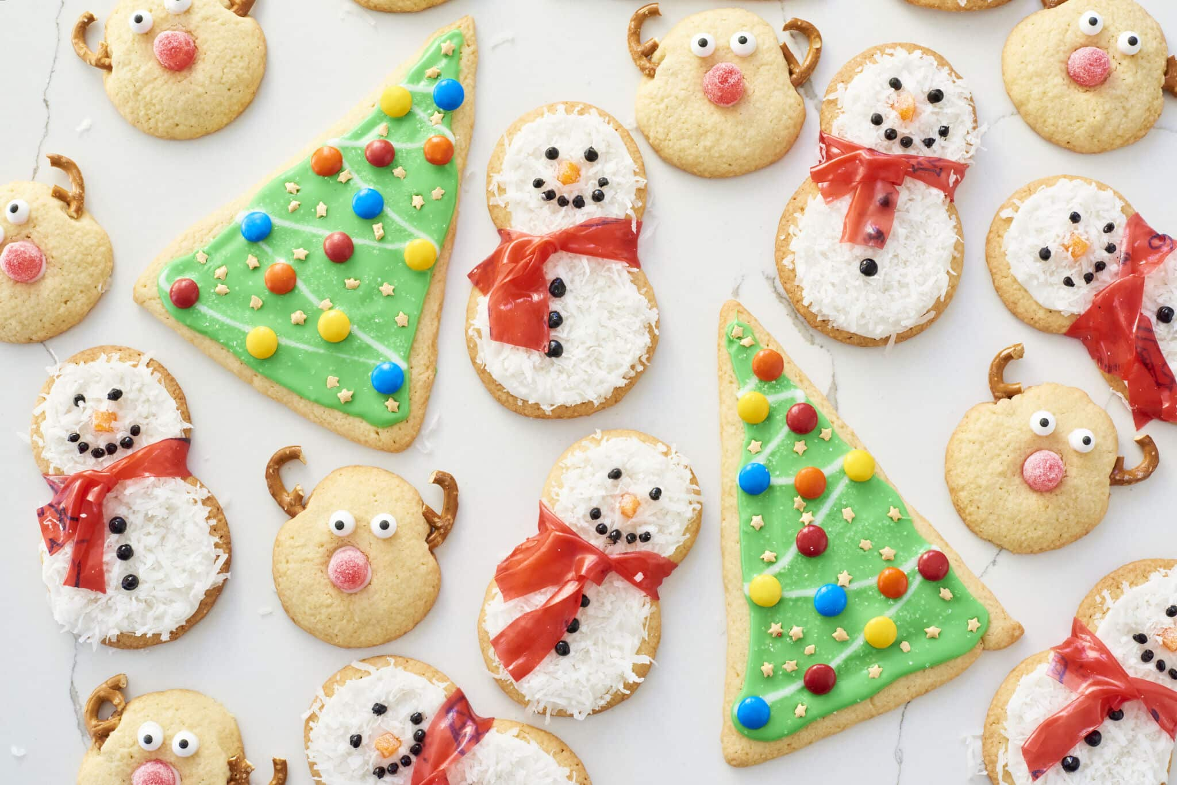
Christmas Non-Cook Cookery
YEAR GROUP: Foundation Stage and Key Stage 1
CLUB LEADER: Mrs Pedley
DAY/TIME: Thursdays 3:15-4pm
1 Children’s University credit per week
Get into the festive spirit with our Christmas Non-Cook Cookery Club! Each week, children will have fun creating delicious and creative Christmas-themed treats — all without using an oven! Pupils will learn simple food-preparation skills in a safe and enjoyable way. It’s the perfect way to mix creativity with a sprinkle of Christmas magic!
CREATIVE

Slide 10
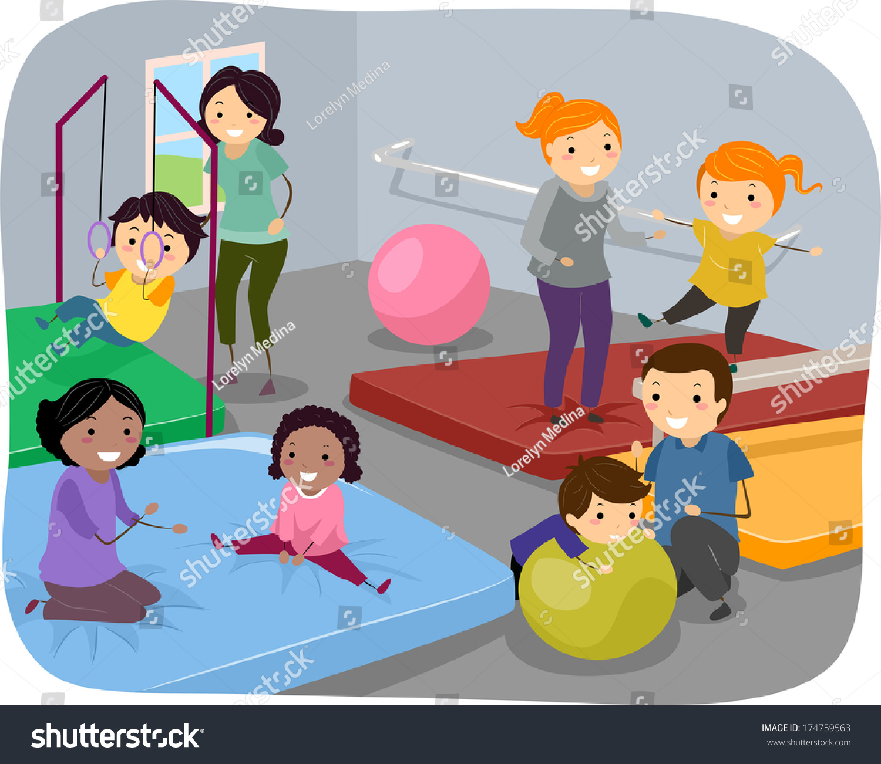
Gymnastics
YEAR GROUP: Year 1 and Year 2
CLUB LEADER: Mr Sigley
DAY/TIME: Monday 3:15-4:15pm
1 Children’s University credit per week
Get ready to jump, roll, stretch, and balance! Our Gymnastics Club is a fun and exciting way for children to develop strength, flexibility, coordination, and confidence. Each week, pupils will learn new skills such as balancing on beams, forward rolls, cartwheels, and simple routines — all in a safe and supportive environment.
HEALTH AND FITNESS

Slide 11

Handball
YEAR GROUP: Year 3, 4, 5 & 6
CLUB LEADER: Port Vale
DAY/TIME: Tuesday 3:15-4pm
1 Children’s University credit per week
Get ready for fast-paced fun with our exciting Handball Club! Handball is a brilliant team sport that combines throwing, catching, running, and teamwork — perfect for children who love to stay active and work together.
HEALTH AND FITNESS

Slide 12
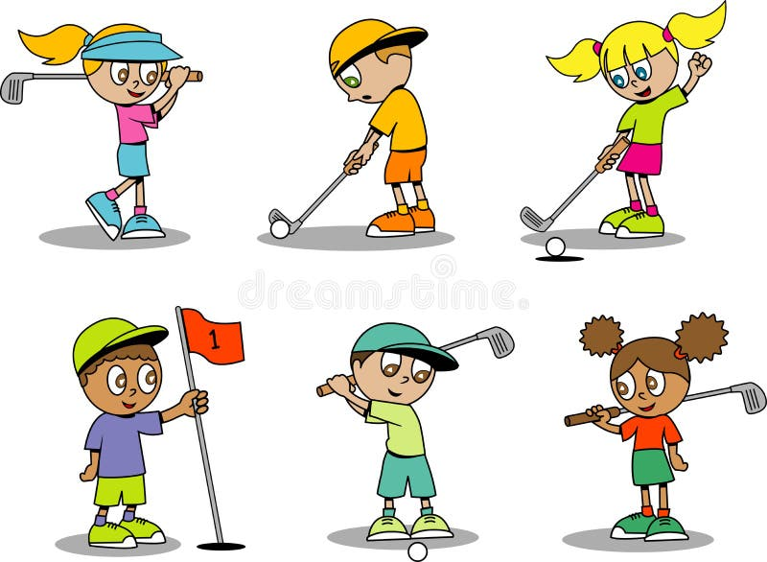
Trio Golf
YEAR GROUP: Year 1 and 2
CLUB LEADER: Port Vale
DAY/TIME: Thursday 3.15pm – 4pm
1 Children’s University credit per week
Swing into action with our fantastic Trio Golf Club! Designed especially for children, Trio Golf is a fun and easy way to learn the basics of golf through exciting games and challenges. Using safe, child-friendly equipment, pupils will practise skills like putting, chipping, and aiming — all while developing coordination, focus, and teamwork.
HEALTH AND FITNESS

Slide 13

Super Singers
YEAR GROUP: Y1-6
CLUB LEADER: Mrs Amison
DAY/TIME: Tuesdays
KS1 3:15PM-3:45PM
KS2 3:15-4:15PM
1 Children’s University credit per week
Imagine singing as part of a choir of up to 9,000 children in a major arena (The largest choir in the world!)
Young Voices gives you the chance to perform in a world-class arena alongside amazing artists – a huge boost to confidence, teamwork and motivation. The chosen songs are fun, upbeat and uplifting and energising. You will also learn some dance moves with Andy and his team from Urban Strides.
PERFORMING ARTS

Slide 14

Dance
YEAR GROUP: Year 3, 4, 5, 6
CLUB LEADER: Mr Case
DAY/TIME: Wednesday 3:15 – 4:30pm
1 Children’s University credit per week
Come along to Street Dance with Mr Case to learn how to dance with energy, rhythm, and style. The club helps you get better at dancing, stay active, and have fun with friends.
PERFORMING ARTS

Slide 15
Children’s University
The Children’s University is an International critically-acclaimed charity which encourages all children aged 5 to 14 years to try new experiences, develop new interests and acquire new skills through participation in innovative and creative Learning Activities outside of the school day.
Learning Activities are designed to:
• Raise aspirations, self-esteem & confidence
• Encourage curiosity and a love of learning
• Enhance motivation and build resilience
• Introduce new life experiences
• Offer progression in learning and personal skills development
From Year 1 the amount of hours spent in after school clubs are recorded. It is the learning hours (credits) achieved that lead to the award of a Children’s University Certificate.
Children are awarded 1 credit for each after-school session they attend. They can also gain credits for educational visits and supporting the school in after school events. Children can also achieve credits if they attend clubs outside of school if they are accredited with the Children’s University.
Children will receive a certificate each year dependent upon the number of credits they have, and if they have achieved the next award.
Certificates start at
Bronze Certificate – 30 credits
Silver Certificate - 65 credits
Gold Certificate – 100 credits
And continue onto Awards, Degrees & Diplomas

Slide 16

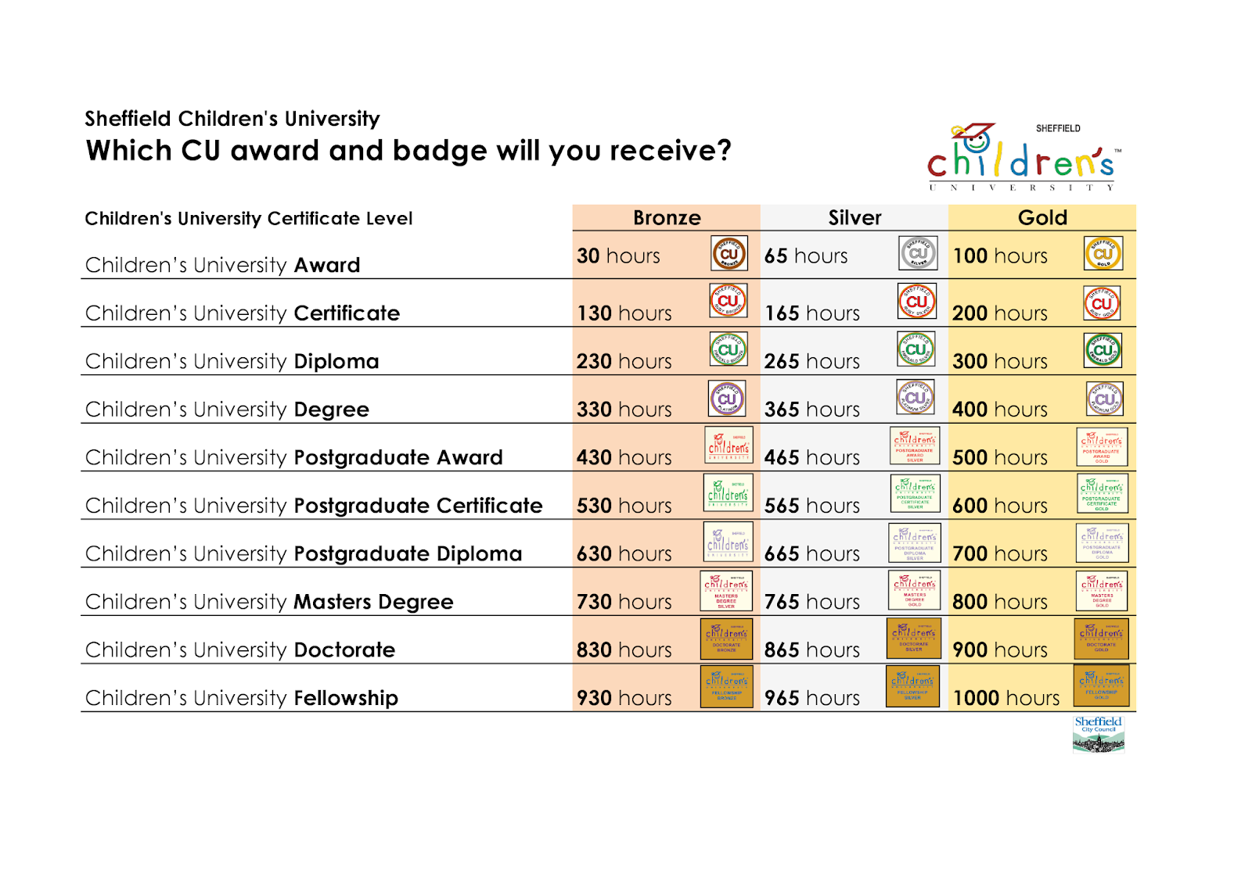
Children’s University
Which Children’s University certificate and badge will you receive?

